Slide 1
Smartphone-Based Facial Video Analysis for Real-Time Vital Sign Estimation
and User Engagement
Jonathan B. Kierce and Aydan A. Kumar

Slide 2
Introduction
Important Concepts:
Remote photoplethysmography (rPPG): An emerging technique that uses video to detect small color changes in the skin caused by blood flow
Atrial Fibrillation (AF): The most common type of heart arrhythmia, a condition where the heart beats irregularly
Heart-Rate Variability (HRV): A measure of the variation in time intervals between heartbeats

Slide 3
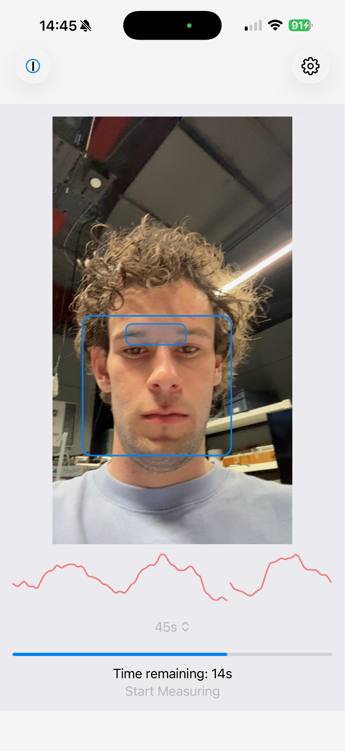
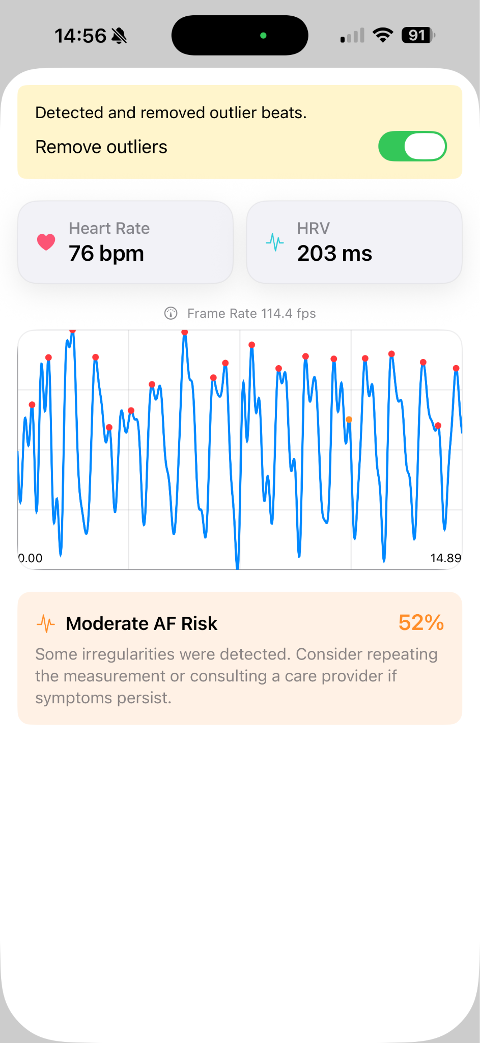
Overview
IOS rPPG application that:
Reports heart-rate
Reports heart-rate variability
Gives an AF probability
Performs A -> C in real-time on iPhone

Slide 4
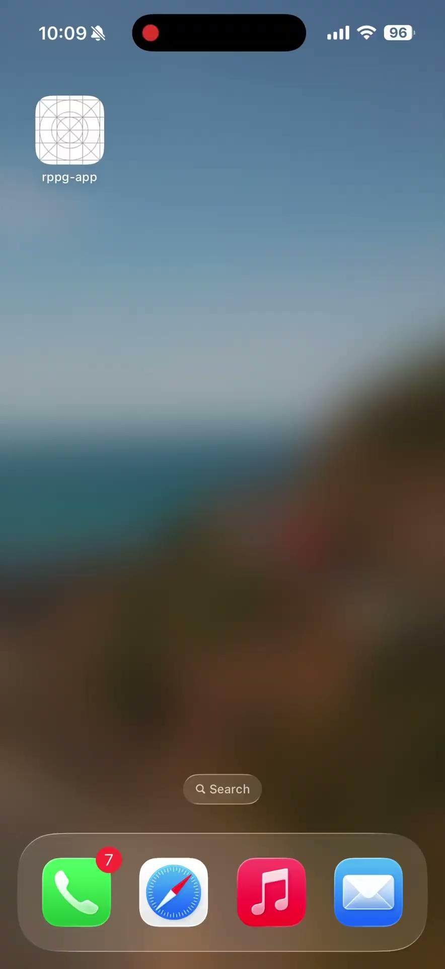

Slide 5
Significance
Contributions
Impact
Utilises Apple Vision framework for real-time ROI detection
Fully processed on device (no external components required)
High AF classification accuracy using logistic regression
Calculated heart-rate and heart-rate variability
Demonstrates potential for continuous health monitoring on phones
AF is the leading cardiac cause of stroke
AF contributed to 9.5% of all deaths in Australia in 2022
HRV is an important health metric related to:
The autonomous nervous system
Blood pressure
Mental well being
Being able to monitor metrics on a common device is very beneficial
No need for additional equipment; accessible and comfortable

Slide 6
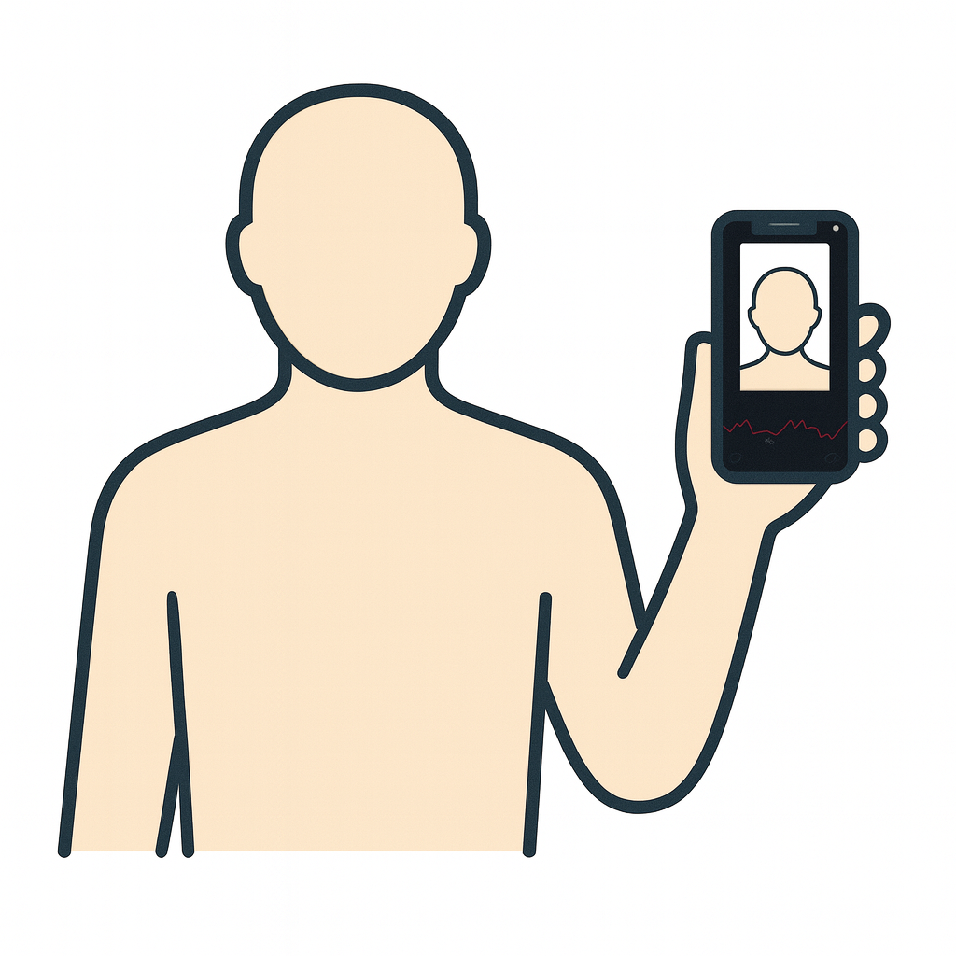
Signal Extraction Methodology
User takes measurement

Slide 7
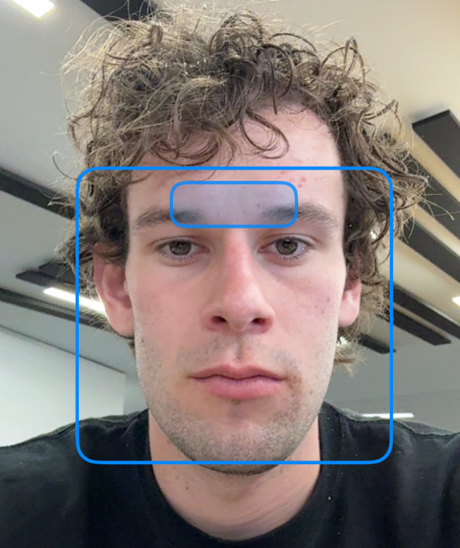
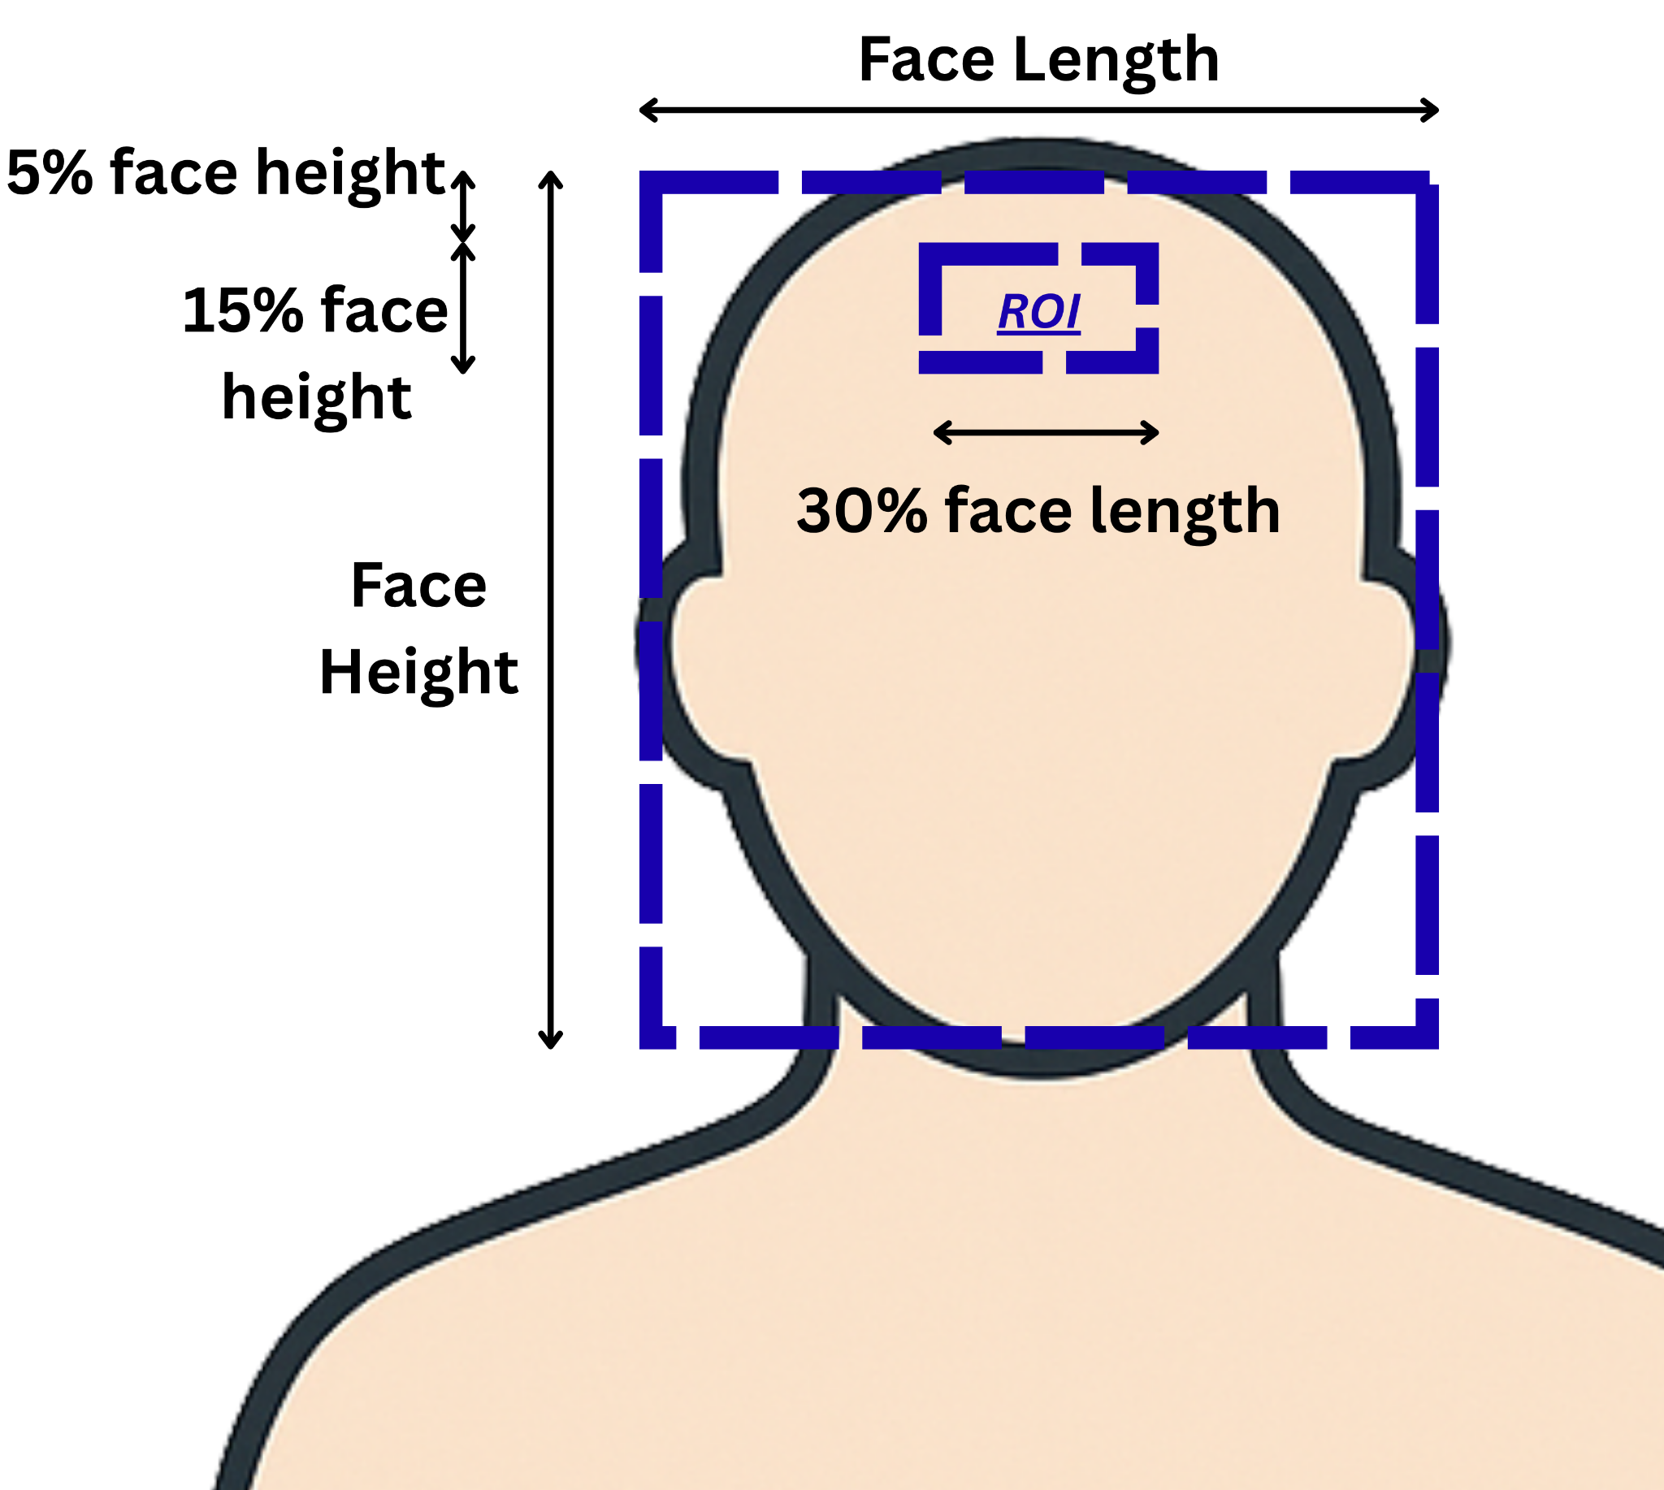
Signal Extraction Methodology - Apple Vision + Region of Interest
¹:https://keiver.dev/lab/apple-vision-vs-yolov11n-for-face-detection-experiment
Apple Vision’s framework used to get facial bounds
Facial detection method chosen as it has consistently higher accuracy and lower memory usage on iOS devices compared to the usually used YOLO detector¹
Forehead referenced from bounding box
User takes measurement
Apple Vision detects face and ROI

Slide 8

Signal Extraction Methodology - Exponential Smoothing
Exponential smoothing reduces frame-to-frame inconsistencies
From testing we chose an alpha of 0.2, meaning the ROI is 20% of the newly detected ROI and 80% of the previous ROIs
User takes measurement
Apple Vision detects face and ROI
ROI is exponentially smoothed w.r.t previous ROIs

Slide 9
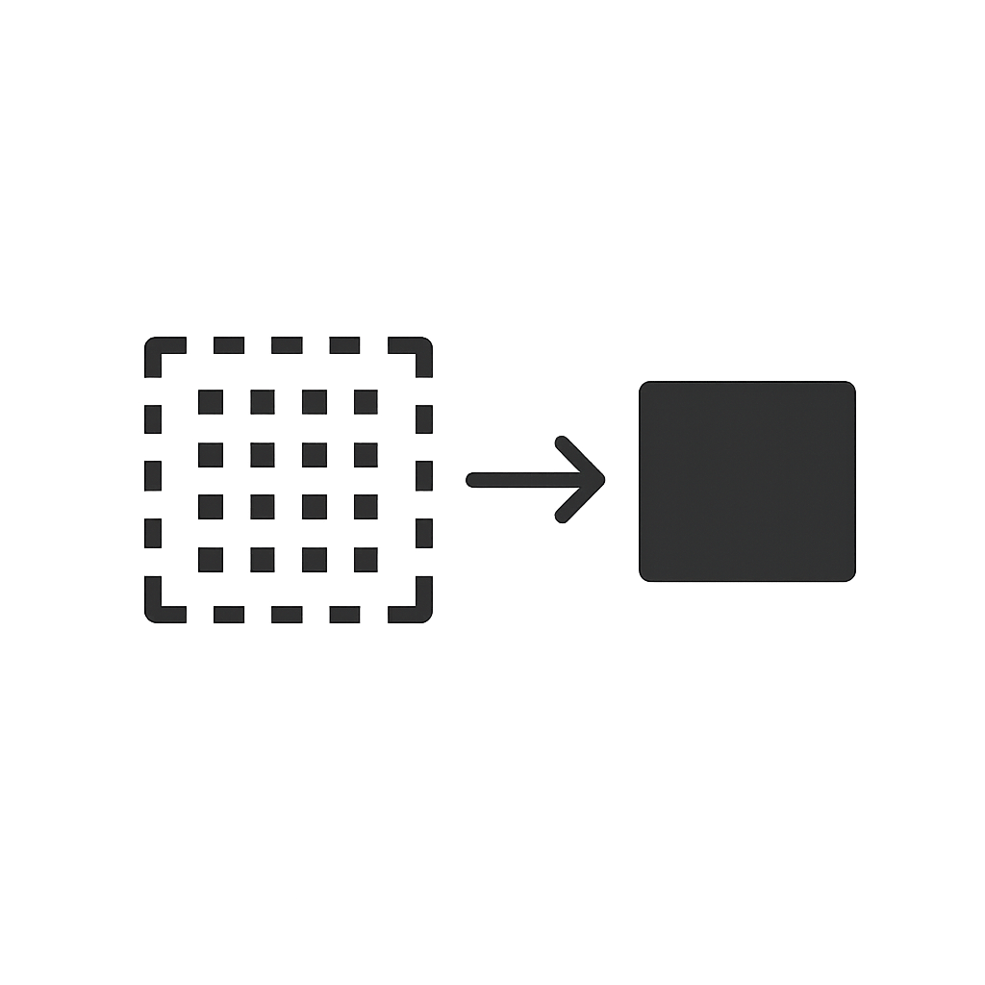
Signal Extraction Methodology - Average pixel values in ROI
User takes measurement
Apple Vision detects face and ROI
ROI is exponentially smoothed w.r.t previous ROIs
Pixel values within ROI are averaged

Slide 10
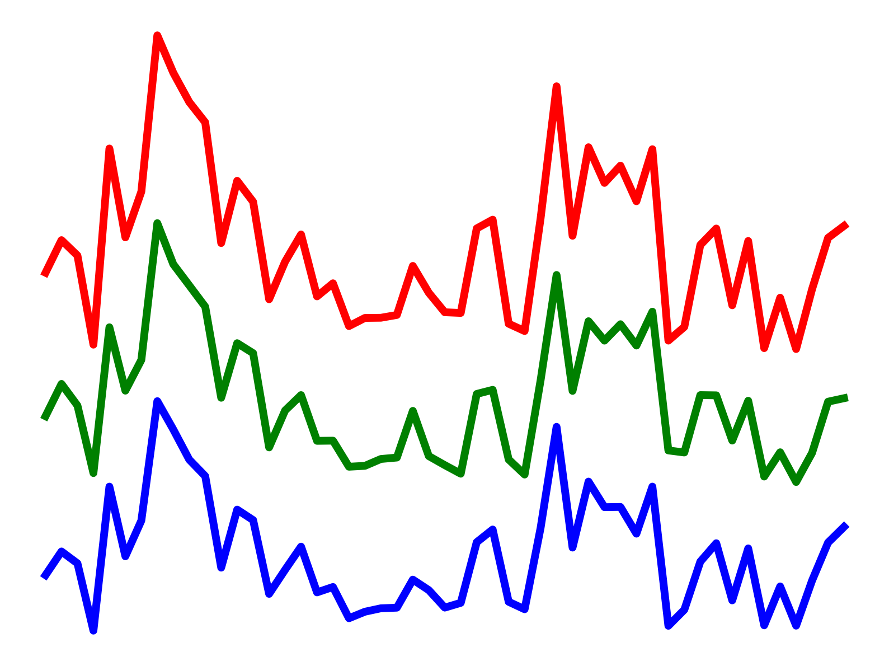
Signal Extraction Methodology - Red Green Blue
User takes measurement
Apple Vision detects face and ROI
ROI is exponentially smoothed w.r.t previous ROIs
Pixel values within ROI are averaged
Red, Green, Blue signal

Slide 11
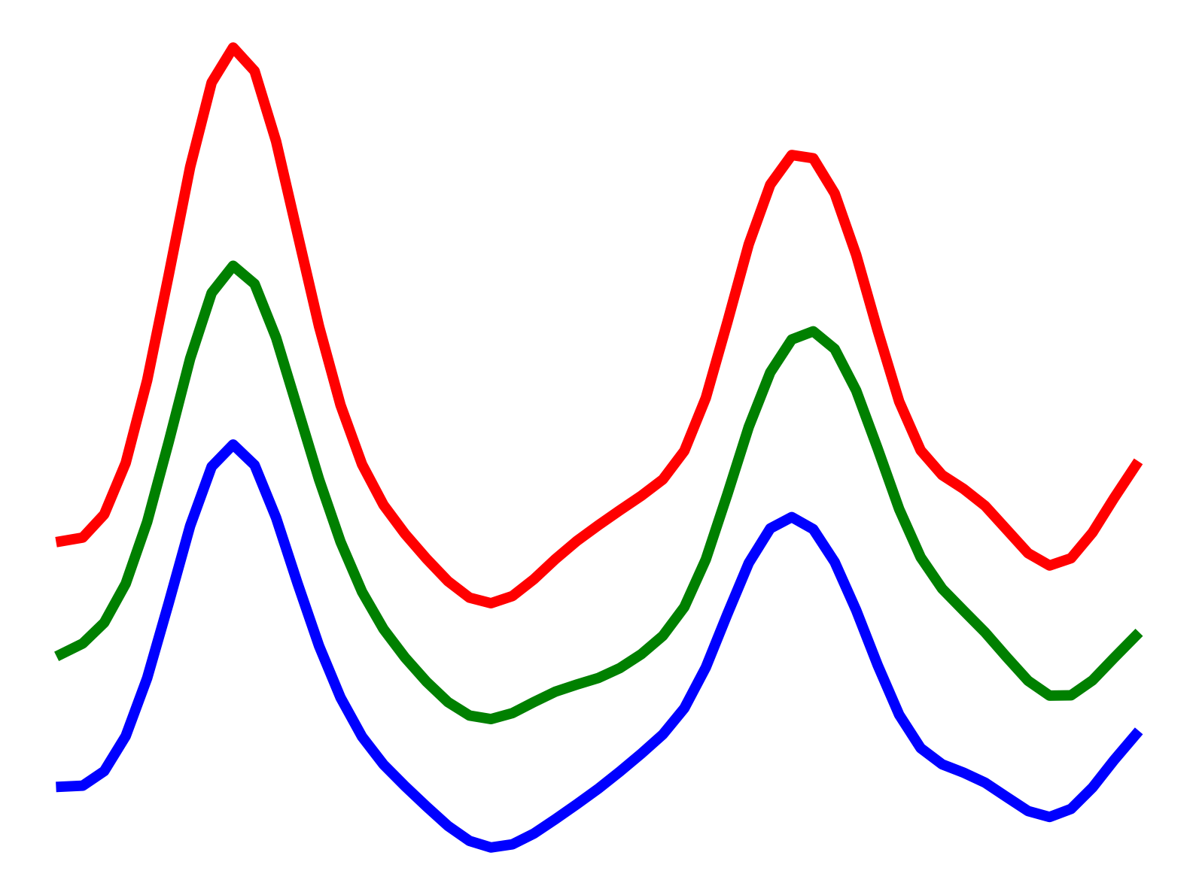
Signal Extraction Methodology - Bandpass Filter
User takes measurement
Apple Vision detects face and ROI
ROI is exponentially smoothed w.r.t previous ROIs
Pixel values within ROI are averaged
Red, Green, Blue signal
Bandpass between 0.7 and 4Hz (42-240bpm)
Runs an FFT, zeros all bins whose absolute frequency is below 0.7 Hz or above 4 Hz, then performs an inverse FFT
Bandpass filter

Slide 12
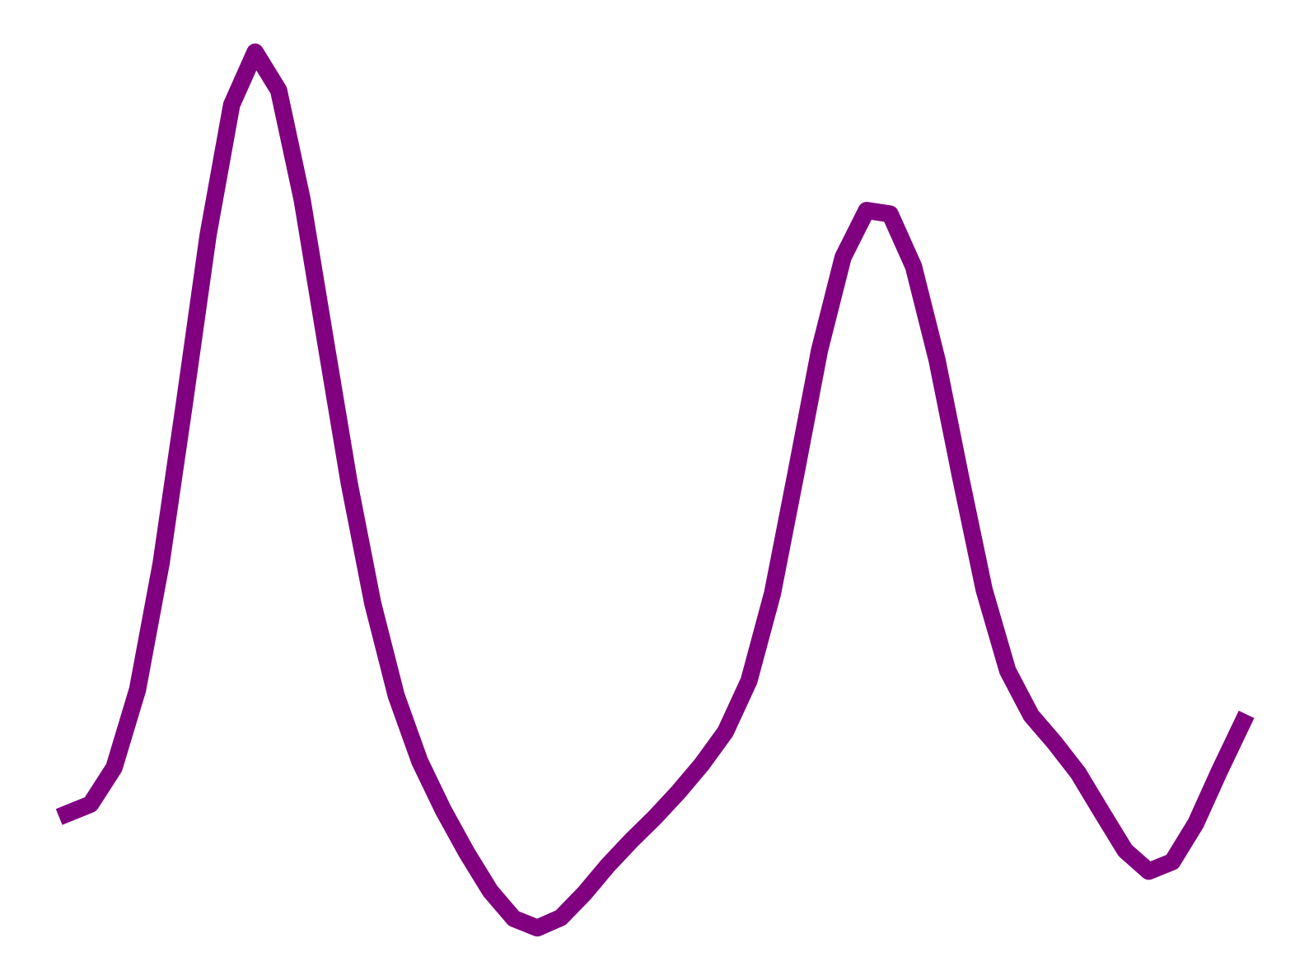
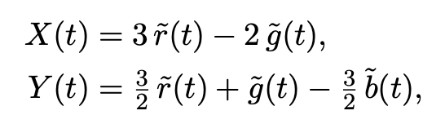
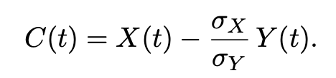
Signal Extraction Methodology - CHROM projection
User takes measurement
Apple Vision detects face and ROI
ROI is exponentially smoothed w.r.t previous ROIs
Pixel values within ROI are averaged
Red, Green, Blue signal
Uses the method suggested by de Haan et al.
The idea of this projection is to emphasise the green-dominated pulse component
Bandpass filter
CHROM projection

Slide 13
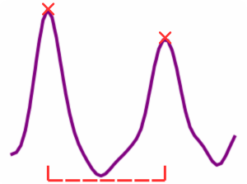
Signal Extraction Methodology
User takes measurement
Apple Vision detects face and ROI
ROI is exponentially smoothed w.r.t previous ROIs
Pixel values within ROI are averaged
Red, Green, Blue signal
Once we have one waveform, peak detection can be performed.
Detected peaks (heartbeats) locations then feed the inter-beat interval calculation
Bandpass filter
CHROM projection
Peak detection -> Inter-beat interval calculation

Slide 14
Signal Extraction Methodology
User takes measurement
Apple Vision detects face and ROI
ROI is exponentially smoothed w.r.t previous ROIs
Pixel values within ROI are averaged
Red, Green, Blue signal
1. Heart Rate Calculation
2. Heart Variability Calculation
3. Atrial Fibrillation Model
Calculated by averaging the interbeat interval time, and dividing this by 60 to get beats per minute
Bandpass filter
CHROM projection
Peak detection -> Inter-beat interval calculation

Slide 15
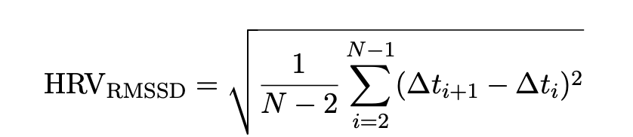
Signal Extraction Methodology
User takes measurement
Apple Vision detects face and ROI
ROI is exponentially smoothed w.r.t previous ROIs
Pixel values within ROI are averaged
Red, Green, Blue signal
1. Heart Rate Calculation
2. Heart Variability Calculation
3. Atrial Fibrillation Model
Uses Root Mean Square of Successive Differences (RMSSD):
Bandpass filter
CHROM projection
Peak detection -> Inter-beat interval calculation

Slide 16
Signal Extraction Methodology
User takes measurement
Apple Vision detects face and ROI
ROI is exponentially smoothed w.r.t previous ROIs
Pixel values within ROI are averaged
Red, Green, Blue signal
1. Heart Rate Calculation
2. Heart Variability Calculation
3. Atrial Fibrillation Model
Bandpass filter
CHROM projection
Peak detection -> Inter-beat interval calculation

Slide 17
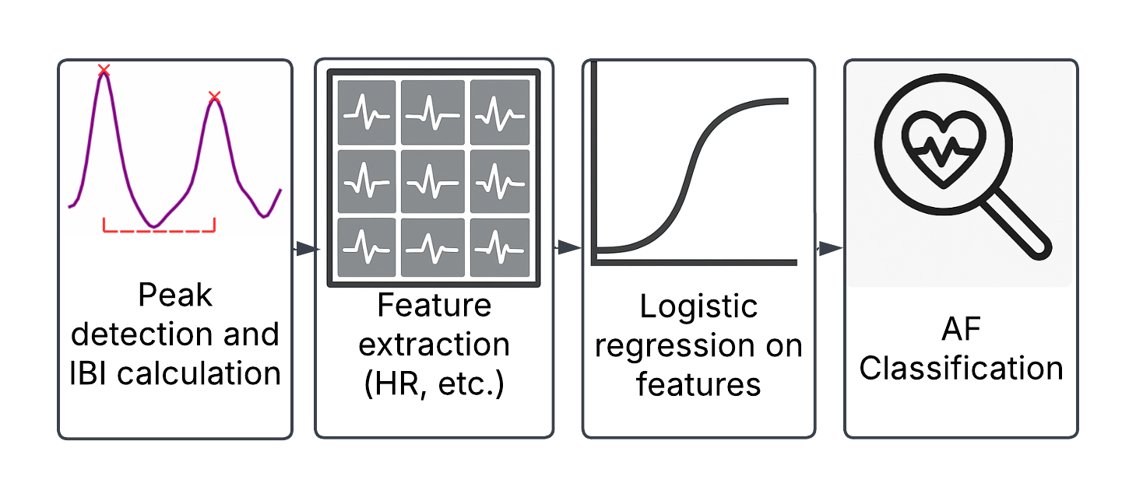
Method - AF
Logistic Regression AF Classifier Metrics
Metric | Value
Accuracy | 94.2%
Sensitivity | 97.5%
Specificity | 89.6%
F1 Score | 95.1%
MIMIC PERform AF Dataset used for model training and testing
11 feature based logistic regression
Logistic regression allows for easy integration into application
Accuracy comparable to deep learning models trained on same dataset (compared with Makynen et al. (2024) )
Limitation: reported accuracy not representative of end-to-end model performance

Slide 18
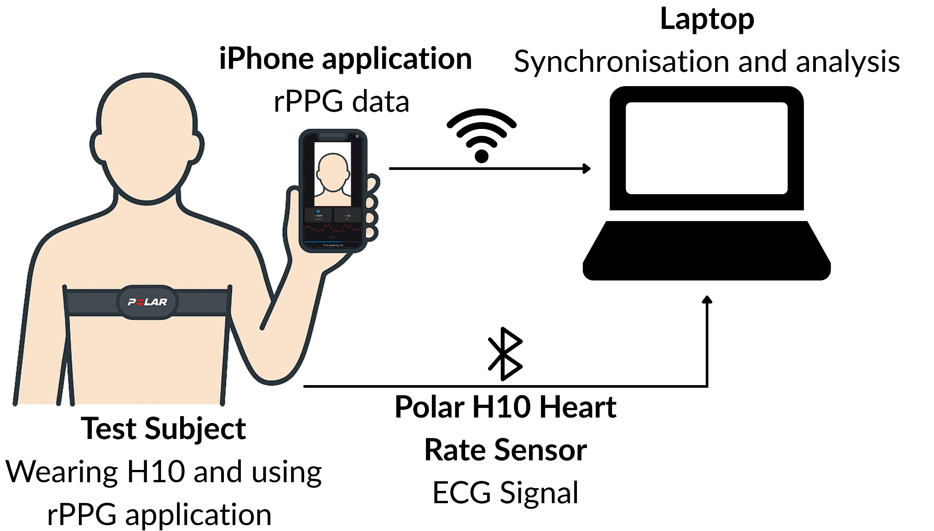
Method - Testing
HR/HRV calculation tested by comparing app to Polar H10 Heart Rate Monitor
10 subjects recorded 10 samples in different settings:
6 ‘standard’ app-use
One paced-breathing trial (6 s inhale, 4 s exhale)
One yes/no Q&A to elicit head motion
HR achieved 1.48 bpm MAE
HRV achieved 63.5 ms MAE

Slide 19
Constraints/Further Improvements
Constraints
Further Improvements
AF:
Limited open-access AF dataset options
Cannot validate end-end application performance
HR/HRV:
HRV impacted by noise and instability in signal
Causes peaks to slightly off, leading to incorrect reporting of HRV
AF:
Compile a fully labelled dataset of AF and non-AF patients recorded using application
Allows system to be fully tested
Deep learning can be explored
HR/HRV:
Can use signal reconstruction to improve HRV (this may impact AF classification performance)
Reduce impact of external noise such as lighting, motion artefacts, etc. in system

Slide 20
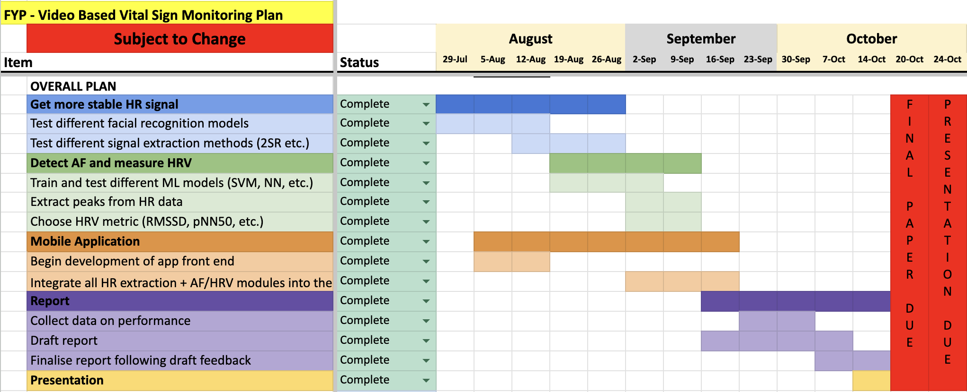
Management/Controls
Gantt chart used to track milestones and ensure timely progress
Weekly supervisor meetings for feedback and progress review
Regular updates and meetings internally to maintain coordination
Split tasks for efficiency:
Jono: App development
Aydan: AF model development
Version control and collaboration using GitHub repositories

Slide 21
Thank you
Any Questions?

Slide 22
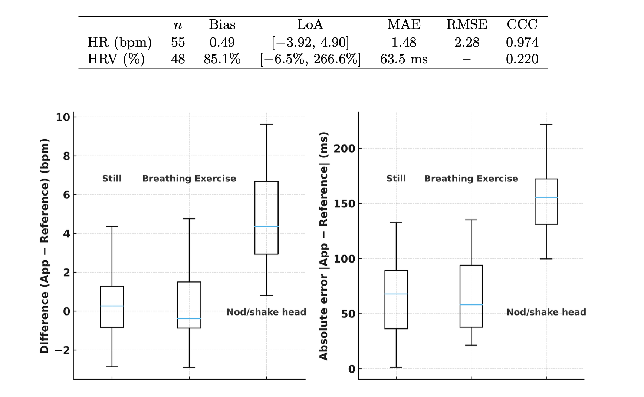
Appendix 1: Experimental Results

Slide 23
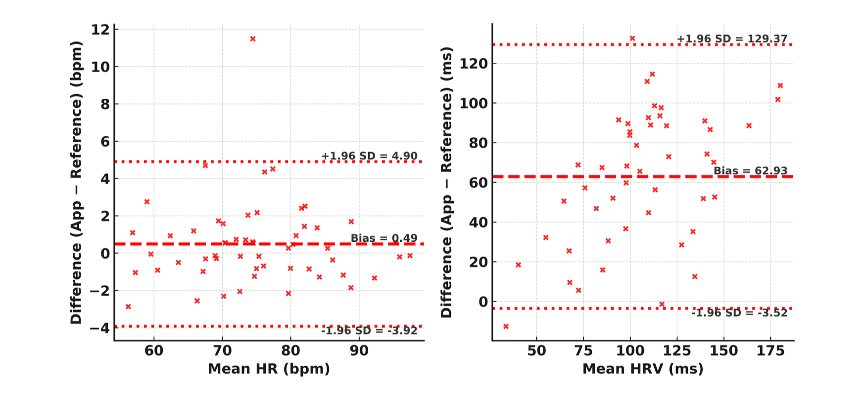
Appendix 2: Experimental Results

Slide 24
Appendix 3: Logistic Regression
=== Feature importance (by coefficient magnitude) ===
Positive coefficients push the prediction towards atrial fibrillation; negative coefficients push towards the non-AF class.
feature coefficient
pnn50 5.524797
hr_mean -1.941102
beats_per_second 1.362622
num_beats 1.362622
mean_rr -1.197353
ppg_std 0.934242
median_rr -0.807944
hr_std -0.733361
std_rr 0.626741
ppg_mean -0.135063
rmssd 0.006282

Slide 25
Appendix 4: Experimental Characteristics
10 subjects were used for validation, comprised of 7 male and 3 female participants (age 30.6 ± 14.9 years; range 18–54). Skin tone was self-reported using the Fitzpatrick phototype scale (types I–VI) (Fitzpatrick, 1988) with I:1,II:3, III:1, IV:4, V:0, VI:1. No participants reported cardiovascular conditions.
Each participant completed eight 30s measurements: (i) six standard app-use recordings; (ii) one paced-breathing trial (6 s inhale, 4 s exhale) to reduce HR; and (iii) one yes/no Q&A trial to elicit head motion.

